Slide 1

Swaraj Wattamwar
jensen huang
150096724157
Notes:
1

Slide 2


Capitalism vs. Communism: A Comparative Case Study
This presentation explores the fundamental differences between capitalism and communism, examining their economic principles, political structures, and social implications. We'll analyze historical context, real-world examples, and ongoing debates surrounding these influential systems.
Notes:
2

Slide 3

Defining Capitalism: Core Principles
Private Ownership
Free Market
Individuals and businesses own the means of production.
Supply and demand determine prices and resource allocation.
Profit Motive
Limited Government Intervention
The pursuit of profit drives economic activity.
The state's role in the economy is minimal.
Notes:
3

Slide 4




Defining Communism: Ideology and Goals
Classless Society
1
Ultimate goal of social equality
2
Common Ownership
Collective control of production means
3
Central Planning
State manages economic activities
4
Abolition of Private Property
No individual ownership of resources
Notes:
4

Slide 5
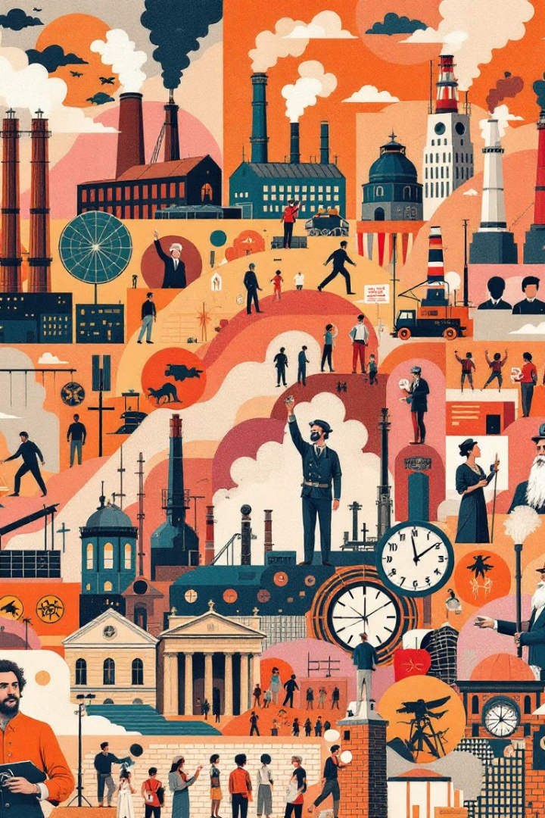
Historical Context: Rise of Capitalism and Communism
1
Industrial Revolution (18th-19th century)
Capitalism emerges as dominant economic system in Western nations.
2
Marx and Engels (1848)
Publication of The Communist Manifesto introduces communist ideology.
3
Russian Revolution (1917)
First major communist state established in Soviet Union.
4
Cold War (1947-1991)
Global ideological struggle between capitalist and communist blocs.
Notes:
5

Slide 6
Comparative Economic Systems: Production, Distribution, and Consumption
Capitalism
Communism
Private ownership of production means
State ownership of production means
Market-driven distribution
Centralized distribution
Consumer choice in consumption
State-determined consumption patterns
Notes:
6

Slide 7




Political Structures: Individual Rights vs. State Control
Capitalism: Limited Government
Focus on individual liberties and property rights
Mixed Systems
Blend of free market and government regulation
Communism: Strong Central Authority
Emphasis on collective good over individual interests
Notes:
7

Slide 8

Social Implications: Equality, Class, and Quality of Life
Capitalism
Communism
Potential for social mobility, but risk of income inequality
Aims for social equality, but may limit personal freedoms
Education
Healthcare
Capitalist: varied options. Communist: state-controlled, often free
Capitalist: private/public mix. Communist: universal state-provided
Notes:
8

Slide 9



Examples of Capitalist and Communist Economies
United States
China
Cuba
Leading capitalist economy with strong emphasis on free markets
Communist political system with market-oriented economic reforms
Traditional communist economy with recent limited market reforms
Notes:
9

Slide 10

Strengths and Weaknesses of Each System
System
Strengths
Weaknesses
Capitalism
Innovation, efficiency, economic growth
Inequality, environmental concerns, market failures
Communism
Social equality, job security, basic needs met
Lack of incentives, inefficiency, limited personal freedoms
Notes:
10

Slide 11





Debate and Criticism: Merits and Challenges
Ongoing Discourse
Hybrid Models
Scholars continue to analyze and debate both systems.
Many countries adopt elements from both capitalist and communist ideologies.
Modern Challenges
Future Developments
Both systems face new issues in the globalized, digital economy.
Economic systems continue to evolve to address societal needs.
Notes:
11

Slide 12

Notes:
12

